Slide 1


Slide 2
Dataset Introduction
Dataset chosen:
Source: Telco Customer Churn CSV (WA_Fn-UseC_-Telco-Customer-Churn.csv)
Size: 7,043 customer records across 21 variables
Target Variable: Churn (Yes/No)
Key Features:
Demographics: gender, SeniorCitizen, Partner, Dependents
Account Information: customerID, tenure (months with company)
Services: PhoneService, MultipleLines, InternetService (DSL/Fiber optic/No), OnlineSecurity, OnlineBackup, DeviceProtection, TechSupport, StreamingTV, StreamingMovies
Billing: Contract (Month-to-month/One year/Two year), PaperlessBilling, PaymentMethod, MonthlyCharges, TotalCharges

Slide 3
Data Import and Initial Inspection
Data Import and Initial Inspection
The dataset was successfully loaded using pd.read_csv(), creating a pandas DataFrame with 7,043 records and 21 variables. Initial inspection confirmed the presence of mixed data types including numeric features (tenure, MonthlyCharges) and categorical variables (Contract, PaymentMethod).
Key Inspection Methods
df.shape - Verified dimensions
df.head() - Previewed structure
df.info() - Checked data types
df.describe() - Summary statistics

Slide 4
Data Cleaning
1. Missing Value Detection - Identified 11 rows with missing TotalCharges requiring handling
2. Data Type Conversion - Converted TotalCharges to numeric using pd.to_numeric() with error coercion
3. Record Removal - Dropped incomplete entries with dropna(), resulting in 7,032 valid records
4. Duplicate Check - Validated no duplicate records exist using df.duplicated().sum()
Feature Engineering
Created ServiceCount by identifying 9 service-related features and calculating subscription totals. This derived metric enables analysis of service bundling patterns and cross-selling opportunities.

Slide 5
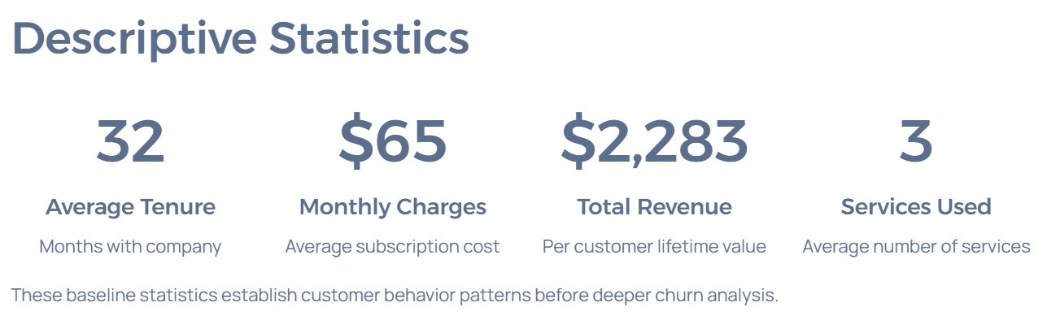
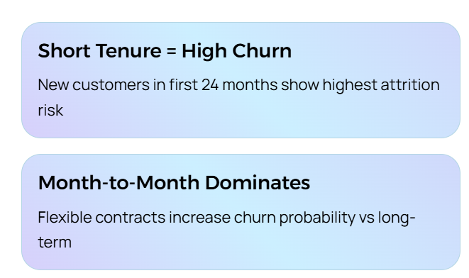
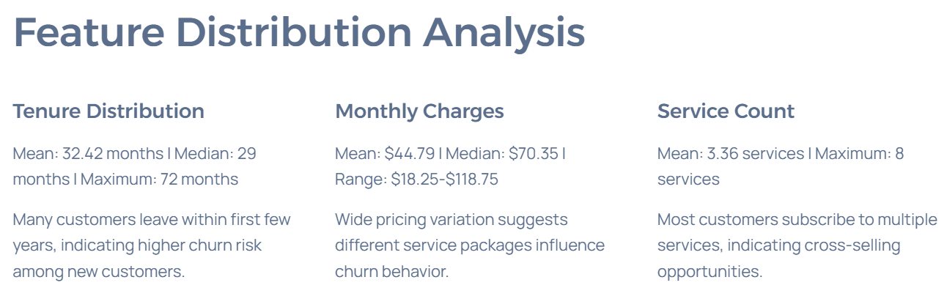
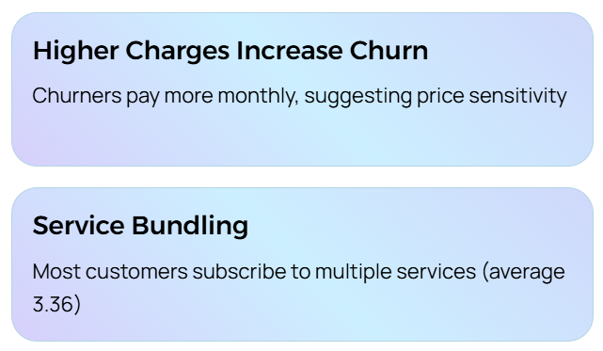
Exploratory Data Analysis (EDA)

Slide 6
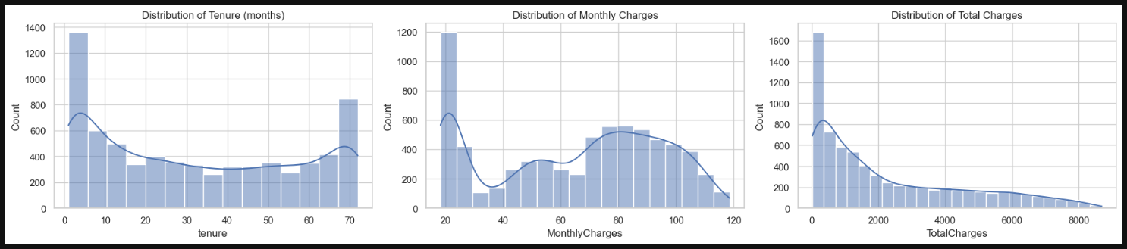
Exploratory Data Analysis (EDA) Data Visualisation
A large proportion of customers leave early in their lifecycle, indicating that new customers are more likely to churn.
The wide variation in pricing suggests customers subscribe to different bundles of telecom services, which may influence churn behavior.

Slide 7
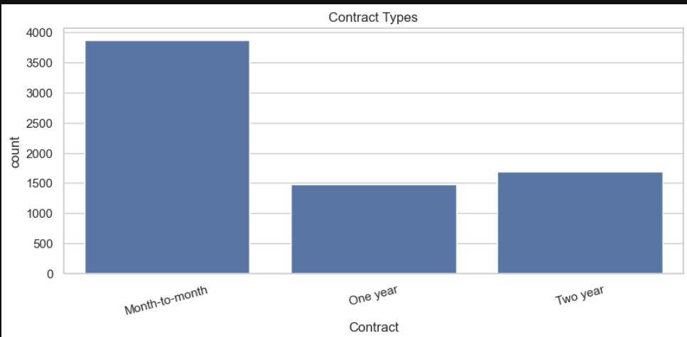
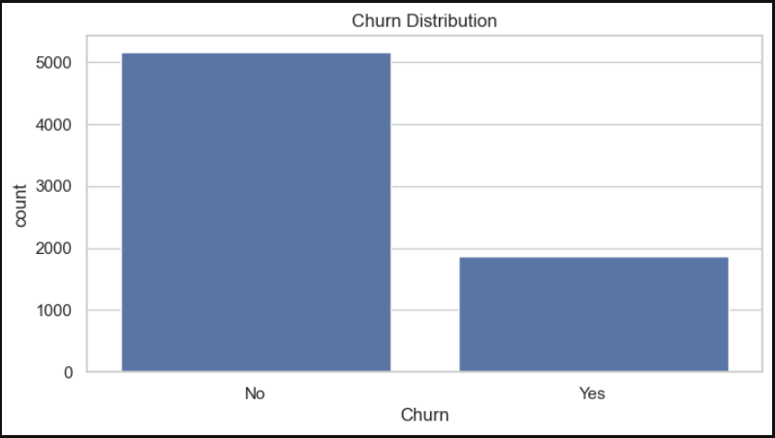
Exploratory Data Analysis (EDA) Data Visualisation
Short-term contracts provide flexibility for customers, but they also increase the likelihood of churn compared to long-term contracts.
Higher service costs may lead to customer dissatisfaction or price sensitivity, increasing the probability of churn.

Slide 8
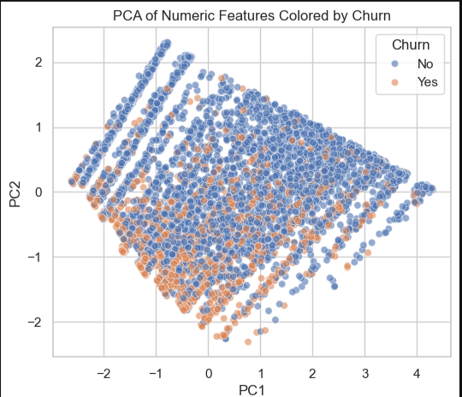
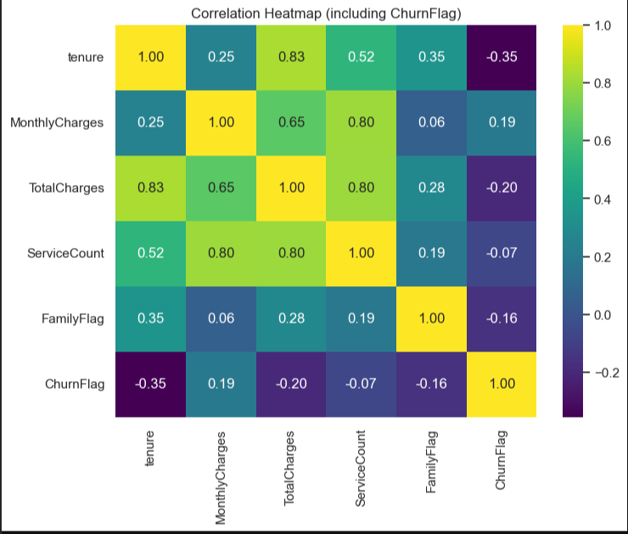
Exploratory Data Analysis (EDA) Data Visualisation
Customers who stay longer are less likely to churn, while higher monthly charges slightly increase churn probability, making these key variables for churn prediction.
This visualization helps identify whether churned and non-churned customers form distinct clusters, indicating that the underlying numeric features contain patterns useful for predicting customer churn.

Slide 9
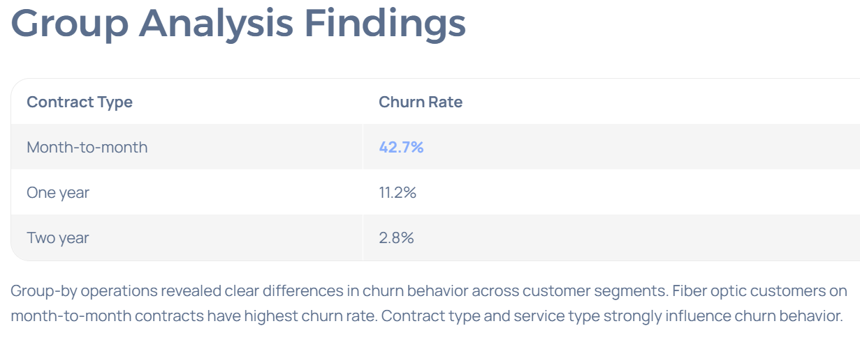
Exploratory Data Analysis (EDA) Group Analysis

Slide 10
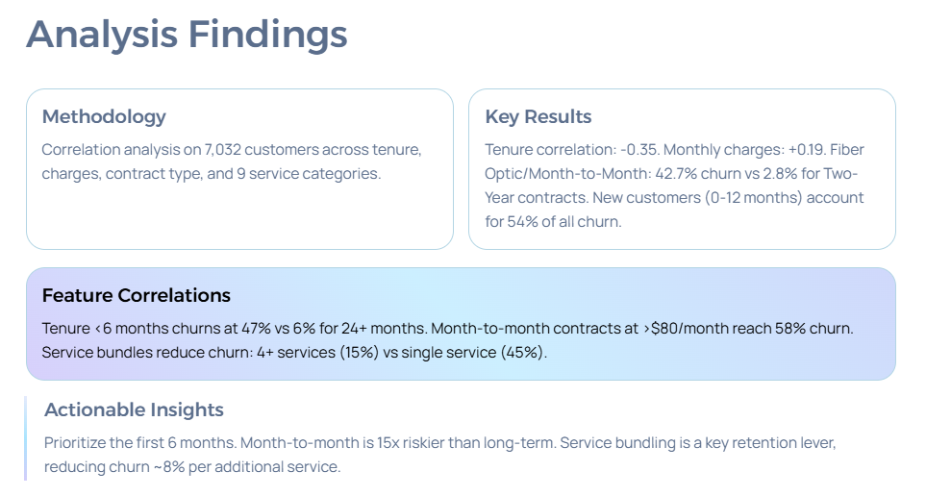
Exploratory Data Analysis (EDA) Feature Analysis

Slide 11
Advanced Python Techniques
Lambda Functions What was done Used lambda functions to perform simple transformations, converting the categorical Churn variable into a numeric flag and grouping tenure into lifecycle stages. Key Result Created new features: ChurnFlag (0 = No churn, 1 = Churn) for statistical analysis TenureGroup (New, Recent, Established, Loyal) for customer segmentation Insight Lambda-based transformations simplified feature engineering and revealed that new customers have a higher churn risk compared to loyal customers. | User-Defined Functions What was done Custom Python functions were created to automate repetitive tasks such as generating dataset summaries, counting services, and detecting outliers using the IQR method. Key Result Reusable functions enabled automated data profiling, outlier detection, and efficient analysis across multiple columns. Insight User-defined functions improved code efficiency, readability, and reusability, making the EDA workflow more scalable and consistent. | List Comprehensions What was done Used list comprehension to efficiently identify specific columns, such as service-related features and columns with missing values. Key Result Automatically extracted relevant columns without manually specifying each one. Insight Improved code efficiency, readability, and scalability for processing datasets with many variables.

Slide 12
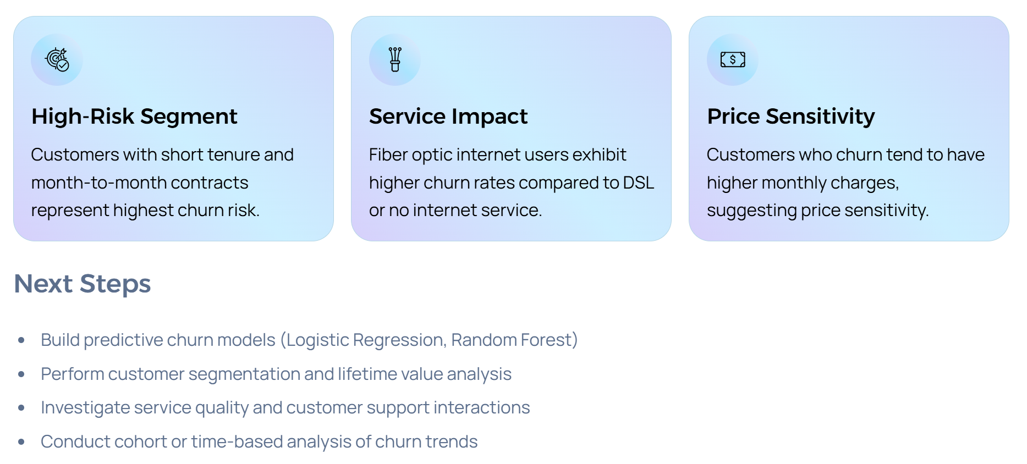
Insights and Conclusions

